Slide 1
Web Design and Development
Gerald Aden
Week 1
Introduction

Slide 2
Introduction Introductions: Me
BS in Math/Computer Science
Over 30 years experience in software development
Xerox, aerospace, finance, telecommunications, legal, banking, transportation, healthcare
Adjunct faculty at PCC teaching various software development courses
Currently work for Surescripts
Current technical interests: IoT, Linux and Containers
New at OIT
gerald.aden@oit.edu

Slide 3
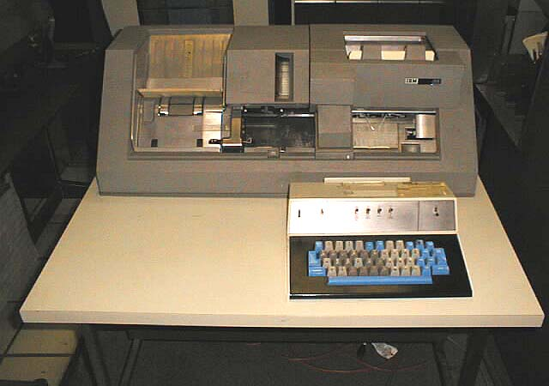
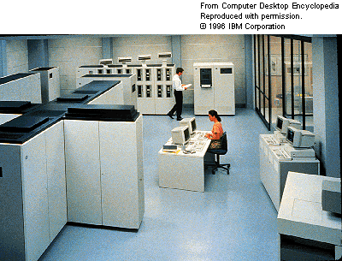
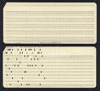

Slide 4
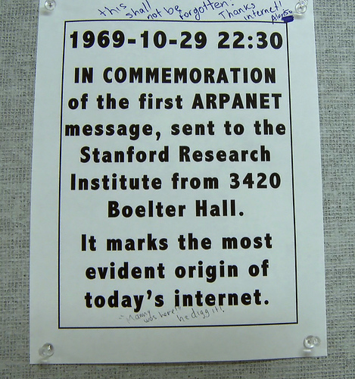

Slide 6
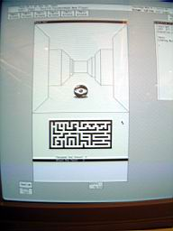

Slide 7
Xerox
Ethernet
File System concept
Mouse
WYSIWYG Editor
Interpress/Postscript/PDF
OOP (Smalltalk)
GUI
Laser Printer
MVC (Smalltalk)

Slide 8
Introduction Introductions: You
Name
Major and year
Experience:
Web technologies (general and Microsoft)
C#
GIT
Database
Visual Studio
Other

Slide 9
Introduction Course: Description
Web development (applications)
Focus on development rather than design
Broad rather then deep (up to you)
Goal is to become acquainted with important aspects of Web application development in a real world environment

Slide 10
Introduction Course: Sessions
Lecture: Monday 6 - 7:50
50 min lecture
10 min break
50 min demos
Lab: Saturday 8 – 10:50

Slide 11
Introduction Course: Grading
Attendance/Participation
Lab exercises 20%
Quizzes 10%
Final 20%
Project 50%
Extra Credit (Lab presentations)

Slide 12
Introduction Course: Communication
Email
Blackboard ?
GitHub
Slack ?

Slide 13
Introduction Course: Topics
ASP.NET MVC
Object Relational Mapping (ORM)
Dependency Injection
Front end development (HTML, JavaScript, CSS, JQuery)
Debugging/Diagnostics
Testing (Unit and acceptance)
Security
REST
Continuous Integration (CI)
Deployment

Slide 14
Introduction Course: Project
Personal Management Application
Relationships with people
Events
Social media (Twitter, Facebook, etc.)
Other
Incorporate material learned
ASP.MVC
Object relational mapping
Dependency Injection
Testing (unit, acceptance)

Slide 15
Introduction Course: Lab
Presentations (optional)
Quiz
Lab Exercise(s)
Time to work on your project and get help

Slide 16
Introduction Course: Tools
Visual Studio
C#
Git/GitHub
GIT for Windows, SourceTree, command line
ReSharper
Fiddler
Postman
Virtual Box

Slide 17
Introduction Course: Resources
https://www.syncfusion.com/resources/techportal/ebooks
http://www.asp.net/aspnet
Others throughout the class

Slide 18
ASP.NET MVC
Model View Controller
Ruby on Rails, Java Spring, Node Sails
Architecture pattern
Standards based
Lowered the level of abstraction from Web Forms
Separation of concerns
Testability
Flexible/Customizable
Current version is 5

Slide 19
ASP.NET MVC Models: What are they?
In memory representation of:
Concrete concepts in your application domain
student, patient, friend etc.
Abstract concepts in your application domain
login attempt, temperature reading, etc.
Content (properties) comprised of data required by your application
Generally only contain data (no methods)
Populated by controllers from data they receive from databases and/or services (REST)
Just a C# class

Slide 20
ASP.NET MVC Models: View Models
Contains data from one or more domain models
Used by MVC views as a source of data

Slide 21
Service A
REST
HTTP Request
Http Response
Data
URL
GET, POST, etc.
Browser
HTTP Request
Web Server
Database
Data
HTTP Response
HTML, JavaScript, JSON, CSS, etc.
HTTP Request
Http Response
Data
Service B
REST

Slide 22
ASP.NET MVC Controllers
Provide an HTTP interface for clients (browsers)
Requests sent over HTTP from a client are routed to a controller/action
Not a file as in traditional Web applications/sites
Process requests (anything)
Returns response (HTML, JSON, file, etc.) back to client
Contain actions (class methods) that implement an interface to some piece of application logic

Slide 23
ASP.NET MVC Controllers
Should be lightweight (not much if any application logic)
Best practice is to utilize other classes to perform application logic (access data, call REST services, calculations, etc.) to facilitate testability
Name is typically [DomainEntity]Controller
Create and populate models using data they receive from databases and/or services (REST) Just a C# class

Slide 24
ASP.NET Controllers: Routes
Control what controller/action is “mapped” to a URL
Can also specify data mapped from values that are part of the URL
Routes are configured by the developer
URLs
http://www.mysite.com/Details.aspx?personId=123
http://www.mysite.com/person/details/123

Slide 25
ASP.NET MVC Views
Templates
Handle page rendering
Any data is in a defined model
Invoked by a controller
Contain mostly HTML
Contain display logic (careful)
Razor syntax (C#)
Conditionals
Loops
Placeholders for data

Slide 26
ASP.NET MVC Demo: Creating a Project
Creating an ASP.NET MVC project
Conventions (actions -> views, etc.)
Folder structure
Support files
Anatomy of a controller
Route basics
Show app (responsive by resizing browser, etc.)

